Slide 1
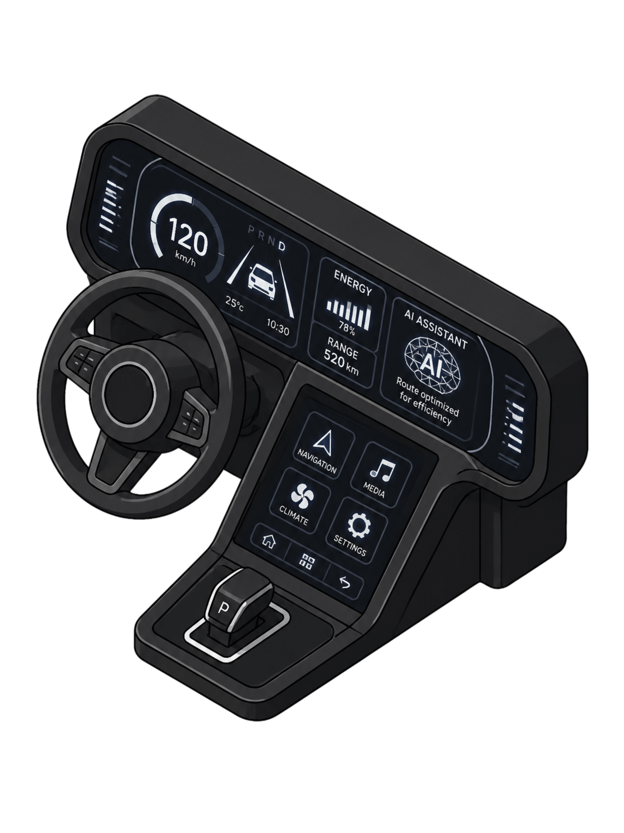
AI-Based Used Car Price Prediction System
Using Natural Language Processing and Machine Learning
Team
Department
Supervisor:Subhranginee das
2510030276-Srija
2510030256-Navya
2510030068-Kiran
2510030140-Anirudh
Computer Science & Engineering
Academic Year
[Your College Name] | 2026–2027

Slide 2


The Problem
Used-Car Data Comes in Two Forms
The Challenge
Traditional ML models cannot directly understand seller descriptions. Critical information in text is ignored, leading to incomplete price predictions.
Structured Data
Year, Mileage, Engine, Fuel Type, Transmission
Our Solution: Combine structured vehicle data + seller descriptions using NLP for a more accurate, informed price prediction system.
Unstructured Text
"Single owner, well maintained, excellent condition, recently serviced."

Slide 3
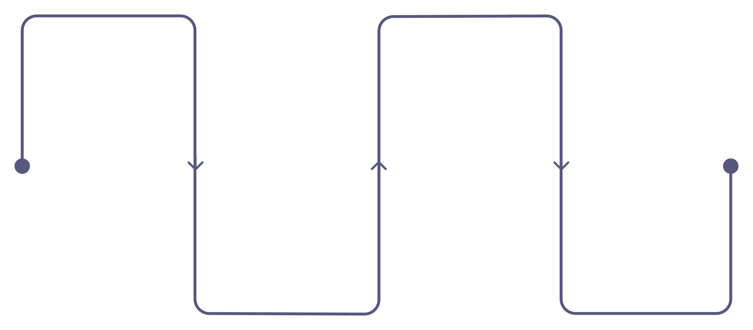
Why Natural Language Processing?
Sellers provide critical pricing signals through free-form text that traditional models simply discard.
Text Input
Feature Extraction
Seller descriptions and notes
Extract signals and embeddings
"Excellent condition, single owner, regularly serviced."
— Typical Seller Description
NLP Extracts Hidden Value
NLP Processing
ML Prediction
Tokenize, clean, and parse
Predict price and confidence
Converting raw seller language into machine-readable signals that power smarter price estimates.
Condition
Ownership
Maintenance
Excellent
Single Owner
Regularly Serviced

Slide 4
Project Objectives
Collect & Preprocess Data
Analyze & Engineer Features
Gather structured vehicle data and seller text descriptions; clean for quality.
Study vehicle attributes, correlations, and extract NLP-derived text features.
Fuse Structured + NLP Features
Train & Evaluate ML Model
Combine numerical vehicle data with text-derived signals into a unified feature set.
Build a regression model, predict used-car prices, and validate performance rigorously.

Slide 5
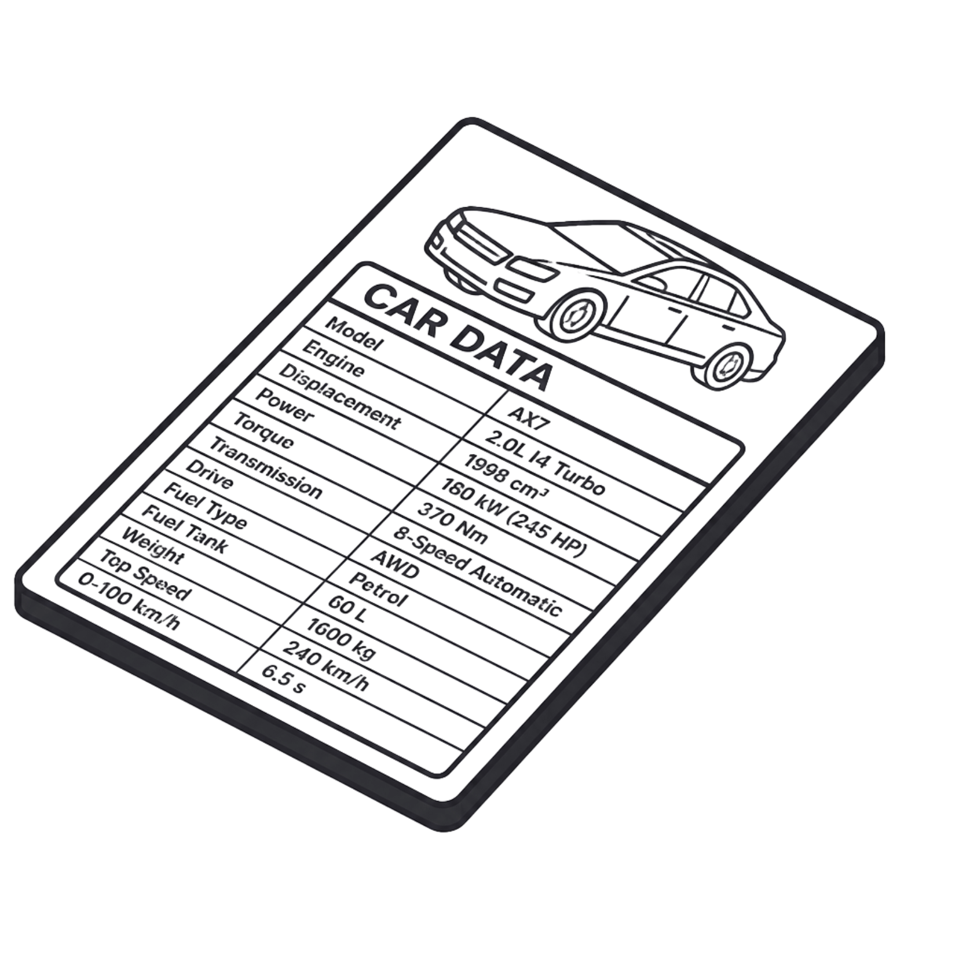
Dataset & Features
Structured Features
Brand, Model, Manufacturing Year
Kilometers Driven, Fuel Type, Transmission
Engine Capacity, Mileage, Owner Type
Text Features (Seller Descriptions)
Vehicle Condition & Maintenance Details
Service History & Accident Information
Additional Features & Overall Description
Target Variable
Selling Price (₹) — the value our model learns to predict.

Slide 6





Natural Language Processing Pipeline
"well maintained single owner car" → numerical features ready for ML
Text Cleaning
Tokenization
Stop-word Removal
Remove special characters, convert to lowercase
Break text into individual words
Eliminate common filler words
Vectorization
Feature Extraction
TF-IDF / Word2Vec encoding
Machine-readable numerical output

Slide 7
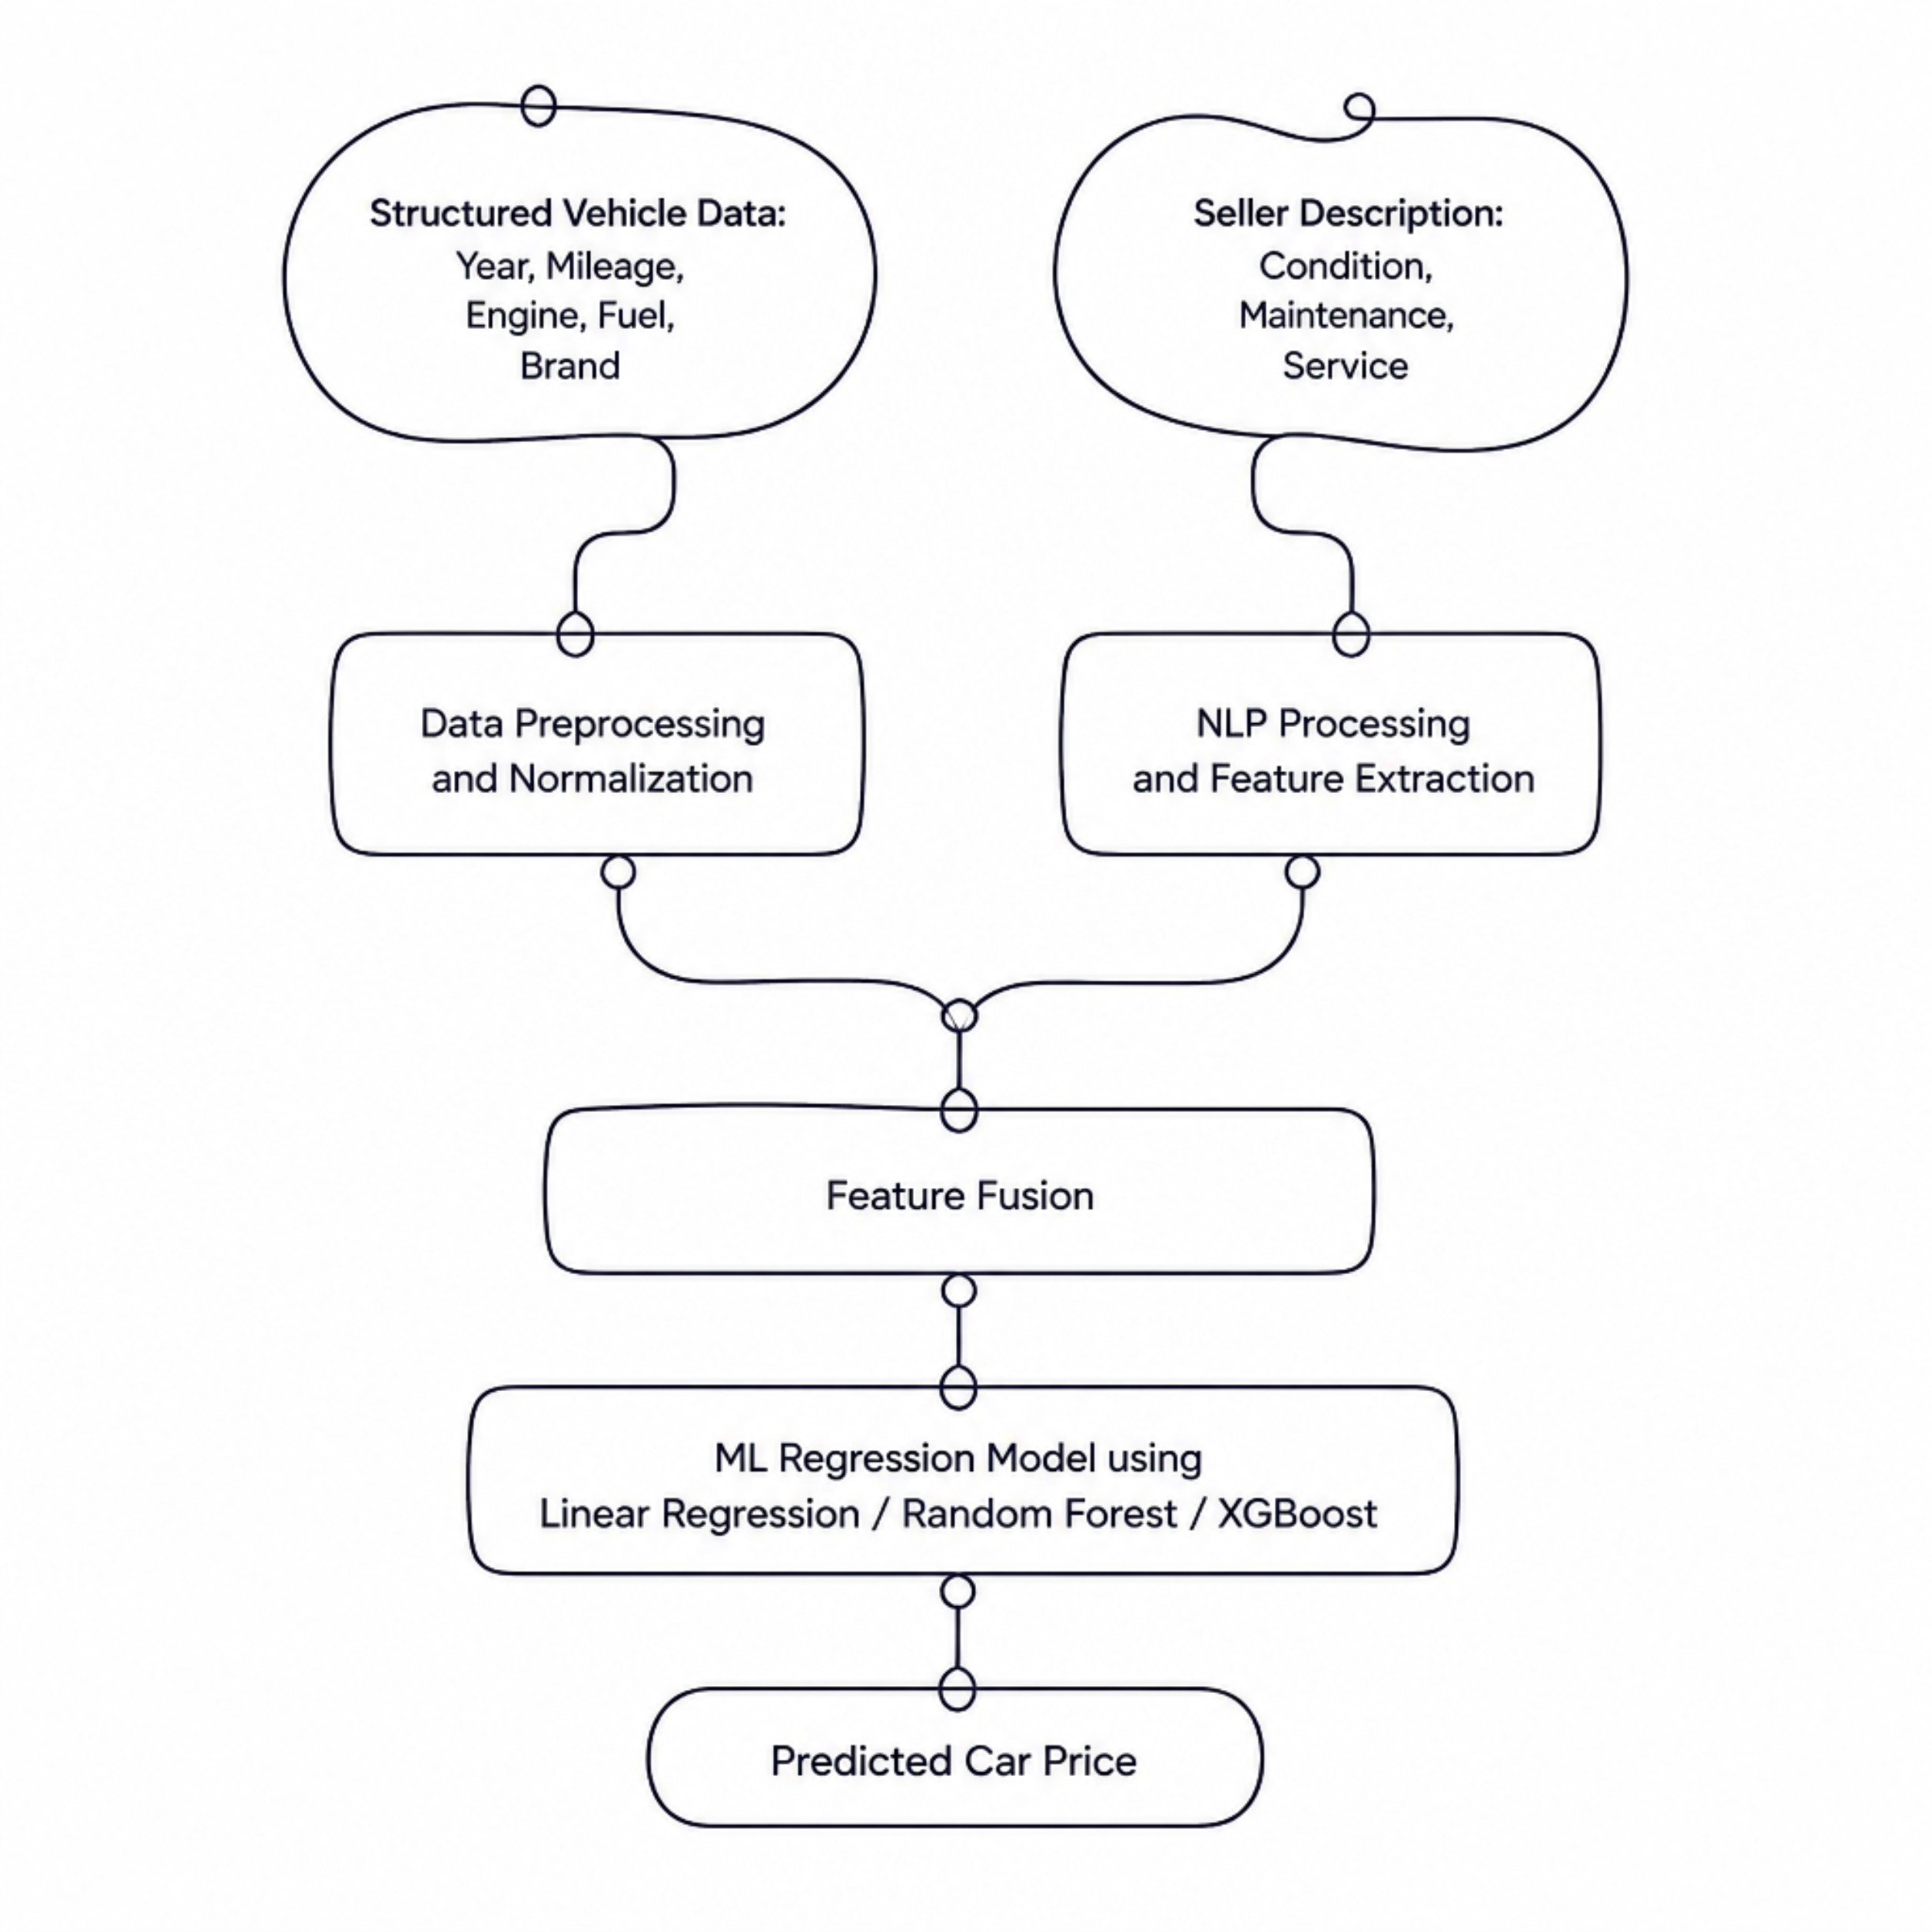

Hybrid NLP + ML Architecture
Input Layer
Structured: Year, Mileage, Engine, Fuel, Transmission, Brand
Unstructured: Seller description text
Processing Layer
Data Preprocessing & Normalization
NLP Processing & Feature Extraction
Fusion & Prediction
Feature Fusion (Structured + NLP Features)
ML Regression — Linear Regression, Random Forest, XGBoost
Output: Predicted Used Car Price ₹

Slide 8





Data Analysis & Model Evaluation
MAE
MSE
Mean Absolute Error
Mean Squared Error
[Enter Actual Value] — Average prediction deviation
[Enter Actual Value] — Penalizes large errors
RMSE
R²
Root Mean Squared Error
R² Score
[Enter Actual Value] — Interpretable error magnitude
[Enter Actual Value] — Variance explained by model
Key Visualizations Generated
Price vs Year
Price vs KM Driven
Brand-wise Avg Price
Fuel Type vs Price
Actual vs Predicted

Slide 9
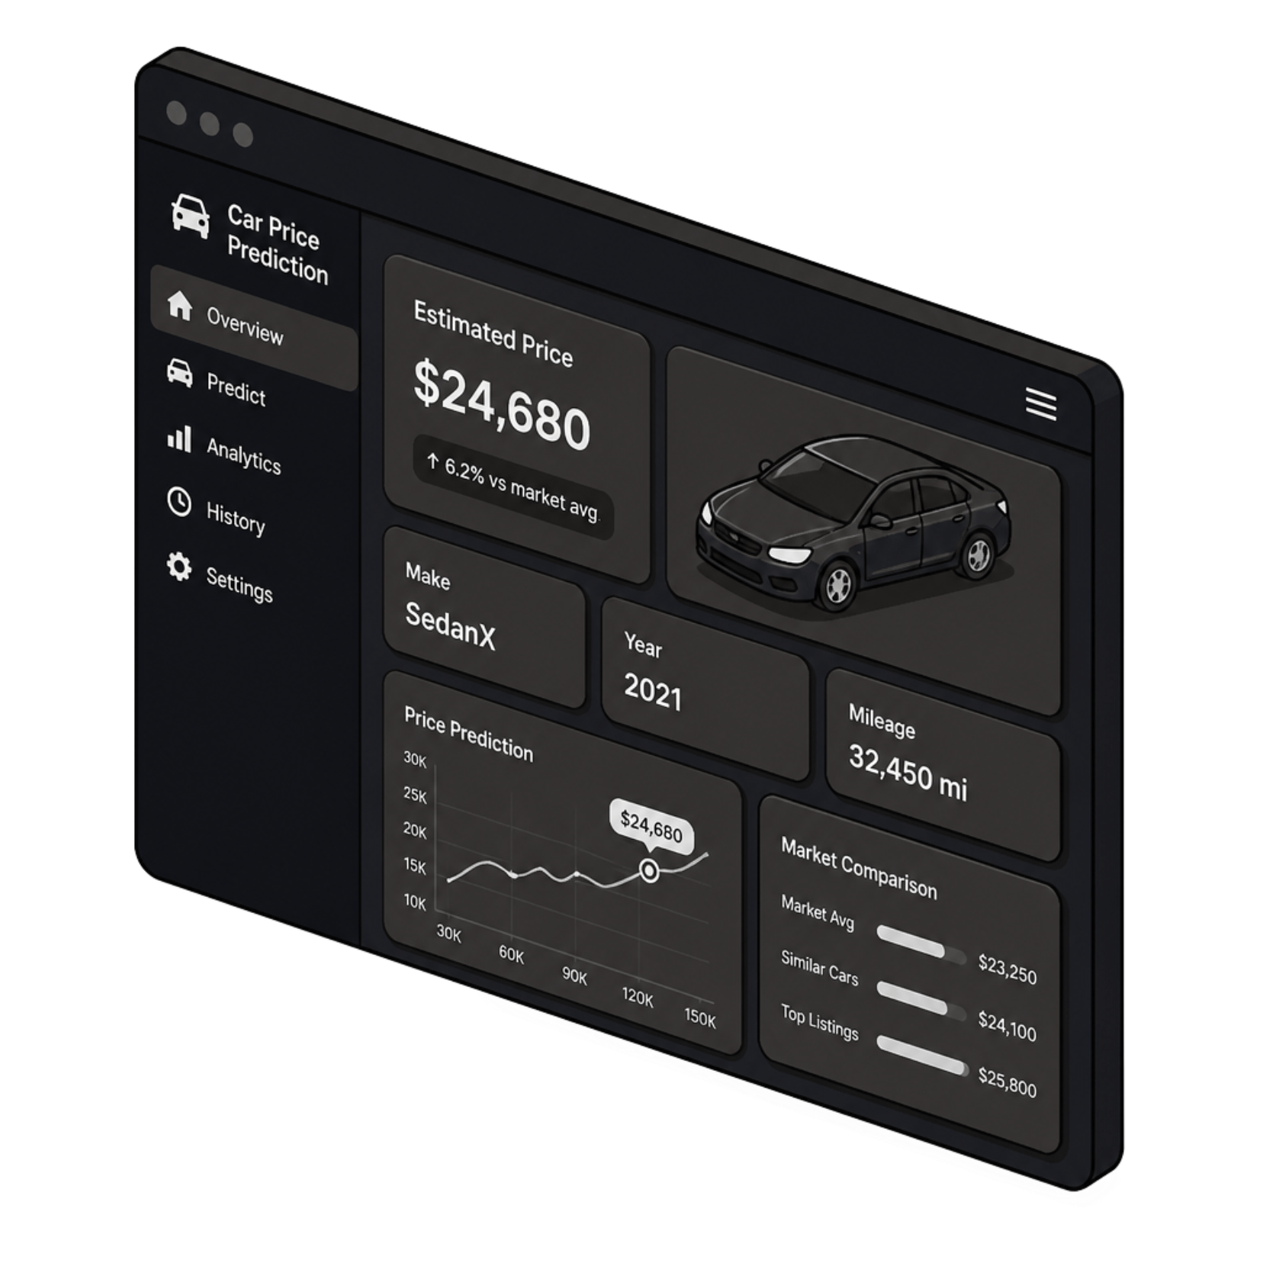
Price Prediction Dashboard
Live Prediction Example
Vehicle Details
Seller Description
AI System Processing
Honda | Year: 2021 | 35,000 km
Petrol | Manual | Condition: Excellent
"Single owner, regularly serviced, well maintained."
NLP Feature Extraction + ML Regression Model
Estimated Used Car Price:
₹X,XX,XXX
Placeholder — replace with actual model output

Slide 10

Conclusion & Future Scope
Key Takeaways
Future Enhancements
Used-car pricing depends on multiple vehicle characteristics
Advanced NLP — BERT, GPT-based embeddings
Seller descriptions contain valuable hidden information
Image-based vehicle condition analysis
NLP converts text into machine-readable features
Real-time market price integration
Hybrid NLP + ML delivers informed price predictions
Web / Mobile application deployment
"Understanding Cars Beyond Numbers — Powered by NLP & AI"
Thank You

